Slide 1
Optimized SIKE Round 2 on 64-bit ARM
Hwajeong Seo¹, Amir Jalali², and Reza Azarderakhsh²
¹Hansung University, ²Florida Atlantic University

Slide 2
Motivation
Target Platform
Proposed Method
Evaluation
Conclusion

Slide 3
Motivation
High performance is important to achieve the service availability
The cryptography imposes the high overheads on computers
Furthermore, some PQC standard show low performance
We target SIKE Round 2 curves, such as SIKEp434 and SIKEp610

Slide 4
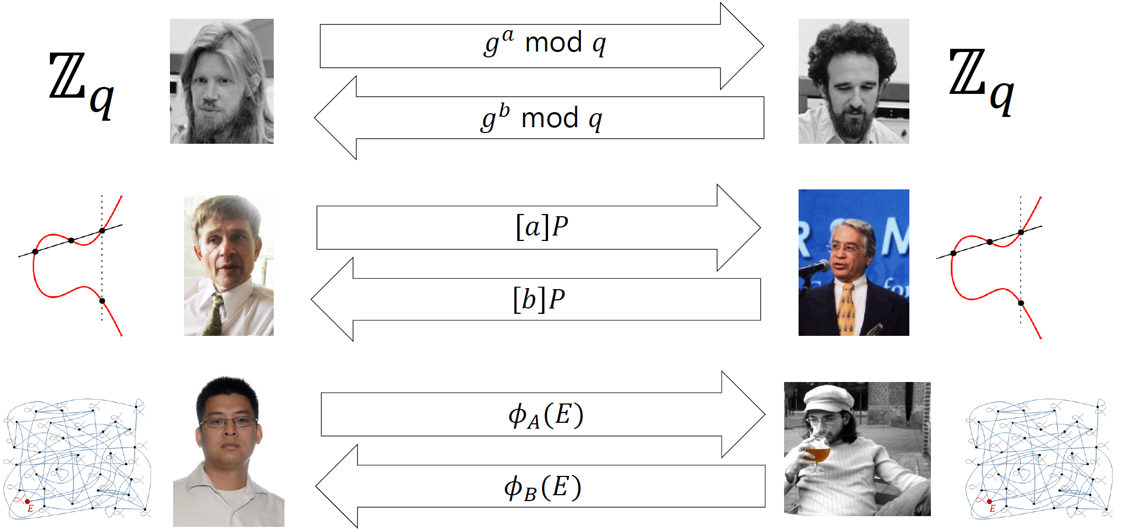
Diffie-Hellman Instantiations

Slide 5
Pre-quantum ECC vs Post-quantum ECC

Slide 6
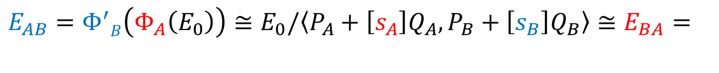


Post-quantum key exchange algorithm
Supersingular Isogeny Diffie-Hellman (SIDH)
Shared key generation between two parties over an insecure communication channel.
SIDH works with the set of supersingular elliptic curves over $𝔽_{p^{2}}$ and their isogenies.
$$E_{AB}=Φ^{′}B\left(Φ_{A}\left(E_{0}\right)\right)≅E_{0}/\left\langle P_{A}+\left[s_{A}\right]Q_{A},P_{B}+\left[s_{B}\right]Q_{B}\right\rangle ≅E_{BA}=$$
$$Φ^{′}A\left(Φ_{B}\left(E_{0}\right)\right)$$

Slide 7
SIKE Round 2
SIKE
One of the PQC candidates
Hardness of solving isogeny maps between supersingular elliptic curves
SIKE Round 1
SIKEp503 (NIST 1), SIKEp751 (NIST 3), and SIKEp964 (NIST 5)
SIKE Round 2
New curves: SIKEp434, SIKEp610
Security level changes: SIKEp503 (NIST 1→2), SIKEp751 (NIST 3→5)
Excluding SIKEp964

Slide 8
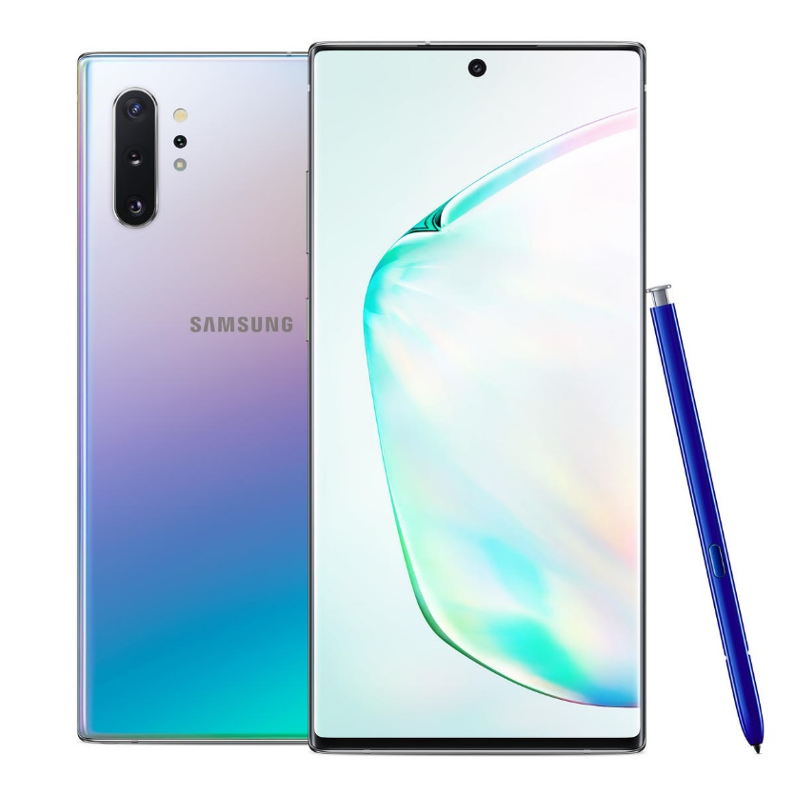
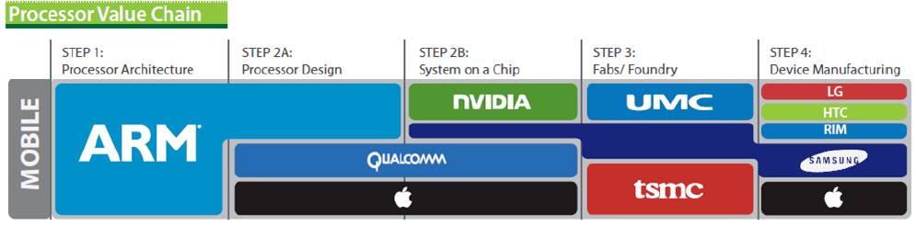
Target Platform – 64-bit ARMv8-A
95% of smartphones based on ARM architecture
Modern smartphone supports 64-bit ARMv8
e.g. iPhone and Galaxy

Slide 9
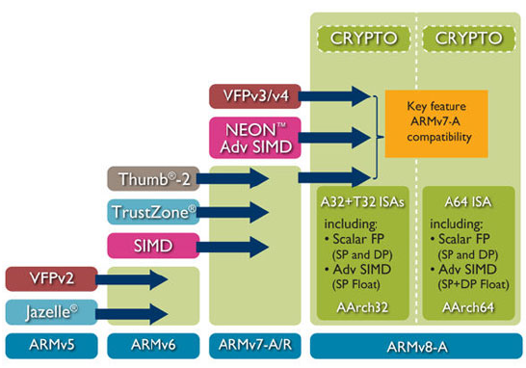
Target Platform – 64-bit ARMv8-A
32-bit mode (AArch32) & 64-bit mode (AArch64)
64-bit ARM & 128-bit NEON registers and instruction sets
Crypto (AES and SHA) operation

Slide 10


Multiplication on ARMv8
X0
a0
X0
a0
$$×$$
$$×$$
X1
b0
X1
b0
a1b0
a0b0
a0b0
a0b0
X3
X2
64 bits
X3
64 bits
X2
MUL
UMULH

Slide 11
Multiplication on ARMv8
SIMD (NEON)
SISD (A64)
V0
a3
a2
a1
a0
X0
a0
32 bits
64 bits
V1
b3
b2
b1
b0
X1
b0
32 bits
64 bits
V2
a1b0
a0b0
a0b0
a0b0
64 bits
X3
X2
64 bits
UMULL
UMULH
MUL
For 64-bit multiplication on ARMv8,
NEON requires 4 UMULL routines but A64 only needs 1 MUL and 1 UMULH.
A64 is more efficient than NEON for big integer multiplication.

Slide 12
Multi-precision Multiplication
256~2048-bit multiplication on 64-bit architecture
Divide big integer (256~2048-bit) into small integer (64-bit)
ARMv8 supports 31x64-bit registers
Method | Operand-scanning | Product-scanning | Hybrid-scanning
Computation order | Row-wise | Column-wise | Mixture of row/column
Requirement | Many registers | Efficient MAC routine | General processor

Slide 13
Multi-precision Multiplication (Product Scanning)

Slide 14
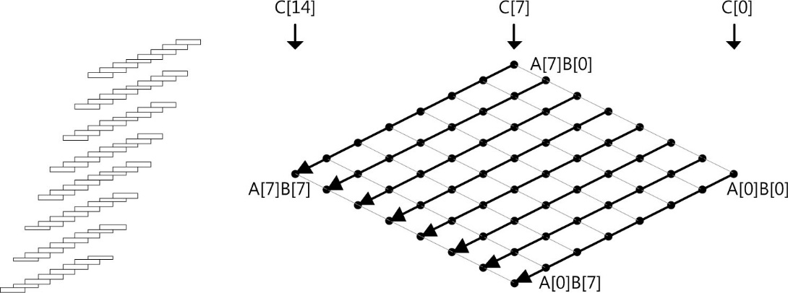
Multi-precision Multiplication (Operand Scanning)

Slide 15
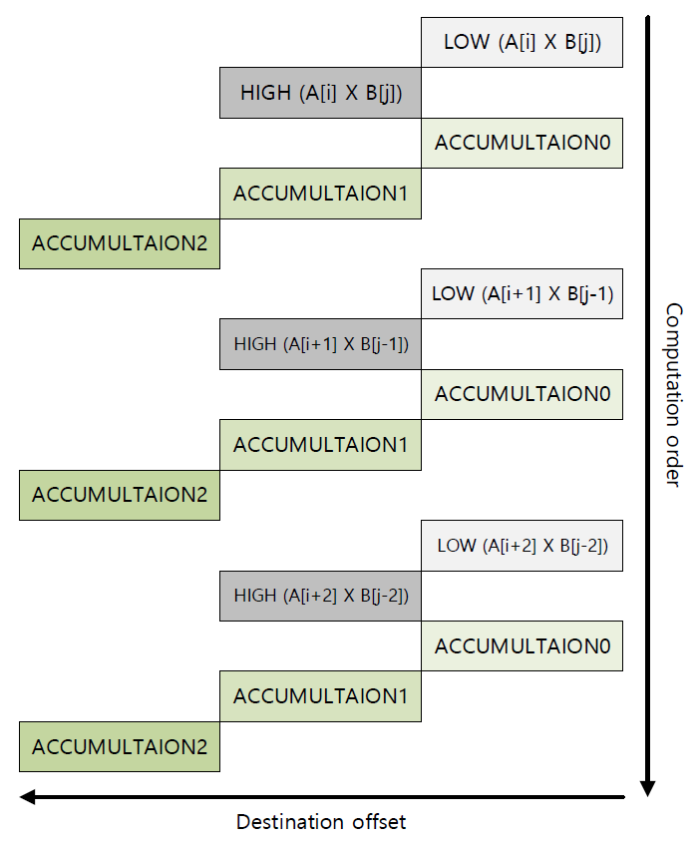
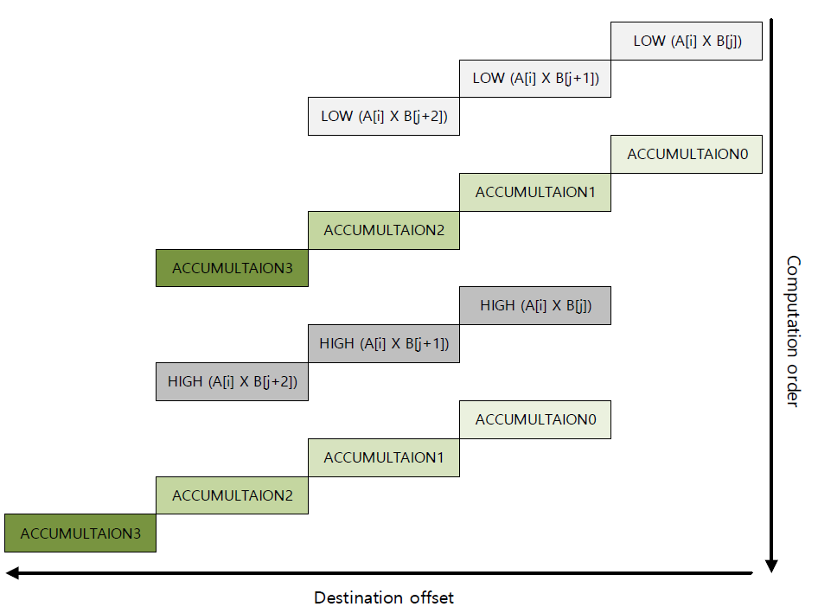
Comparison between Product-scanning & Operand-scanning
9 additions
8 additions
Product-scanning
Operand-scanning

Slide 16
Comparison between Product-scanning & Operand-scanning
Number of addition operations depending on the number of limb
Operand-scanning shows lower number of addition than product-scanning
Method | Number of limb
 | 3 | 4 | 5 | 6 | 7
Operand-scanning | 24 | 40 | 60 | 84 | 112
Product-scanning | 27 | 48 | 75 | 108 | 147

Slide 17
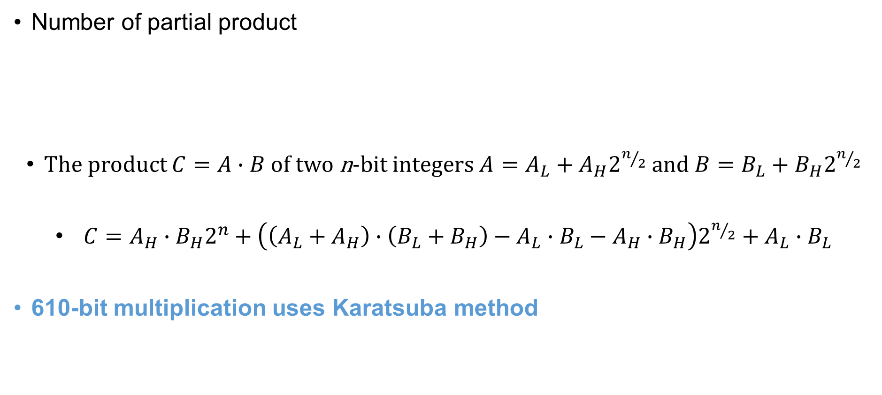
Karatsuba-Ofman Algorithm
Number of partial product
The product $C=A∙B$ of two n-bit integers $A=A_{L}+A_{H}2^{n/2}$ and $B=B_{L}+B_{H}2^{n/2}$
$C=A_{H}∙B_{H}2^{n}+\left(\left(A_{L}+A_{H}\right)∙\left(B_{L}+B_{H}\right)−A_{L}∙B_{L}−A_{H}∙B_{H}\right)2^{n/2}+A_{L}∙B_{L}$
610-bit multiplication uses Karatsuba method
School-book | Karatsuba-Ofman
$$N^{2}$$ | $$N^{\log_{2}{3}}$$

Slide 18
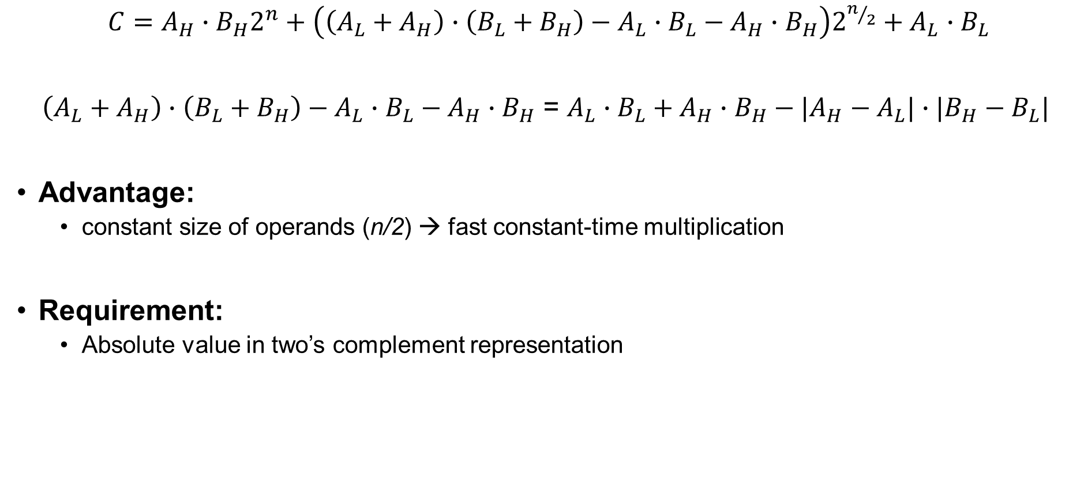
Subtractive Karatsuba Algorithm
$C=A_{H}∙B_{H}2^{n}+\left(\left(A_{L}+A_{H}\right)∙\left(B_{L}+B_{H}\right)−A_{L}∙B_{L}−A_{H}∙B_{H}\right)2^{n/2}+A_{L}∙B_{L}$
$\left(A_{L}+A_{H}\right)∙\left(B_{L}+B_{H}\right)−A_{L}∙B_{L}−A_{H}∙B_{H}$ = $A_{L}∙B_{L}+A_{H}∙B_{H}−|A_{H}−A_{L}|∙|B_{H}−B_{L}|$
Advantage:
constant size of operands (n/2) → fast constant-time multiplication
Requirement:
Absolute value in two’s complement representation

Slide 19
Evaluation
Multiplication implementations for SIKEp434 and SIKEp610 are improved by 4.5x and 4.9x, respectively.
Implementation | Language | Protocol | Timing [cc]
 |  |  | Addition | Subtraction | Multiplication | Inversion
SIKE Round 2 | C | SIKEp434 | 172 | 129 | 3,110 | 1,648,372
This work | ASM |  | 71 | 63 | 691 | 380,711
SIKE Round 2 | C | SIKEp610 | 257 | 187 | 6,599 | 4,800,694
This work | ASM |  | 100 | 91 | 1,329 | 963,064

Slide 20
Evaluation
Total protocols for SIKEp434 and SIKEp610 are also improved by 3.8x and 3.4x, respectively.
SIKEp434 shows the most optimal performance among SIKE curves.
Implementation | Language | Protocol | Timing [cc] | Timing [cc * 10^6]
 |  |  | Multiplication | KeyGen | Encaps | Decaps | Total
SIKE Round 2 | C | SIKEp434 | 3,110 | 114 | 186 | 199 | 499
This work | ASM |  | 691 | 30 | 49 | 52 | 130
Seo et al. | ASM | SIKEp503 | 849 | 38 | 63 | 67 | 168
SIKE Round 2 | C | SIKEp610 | 6,599 | 344 | 634 | 615 | 1,593
This work | ASM |  | 1,329 | 99 | 183 | 183 | 465
Seo et al. | ASM | SIKEp751 | 2,450 | 164 | 265 | 284 | 713

Slide 21
Conclusion
Achievements
Efficient implementations of multi-precision multiplication on ARMv8
First implementation of SIKE Round 2 curves on ARMv8
Future works
Further cryptography implementations (other SIKE and PQC)

